Slide 1

Impact of COVID-19 on music
Team: Ratna Jadhav, Michael Sorensen, Schaefer Shaughnessy, Seong-Min Kim
Spotify Project 1 GitHub Link
Notes:
Review the talking points for each slide
Graphs for last question
Need to fix clean up notebook- Picture of jupyter notebook for data clean up
Edit language for definition of Acousticness
Analysis for each graph + other questions
Overall findings slide
Factors to keep in mind slide
Additional Questions slide
Add slide: all names of notebooks

Slide 2
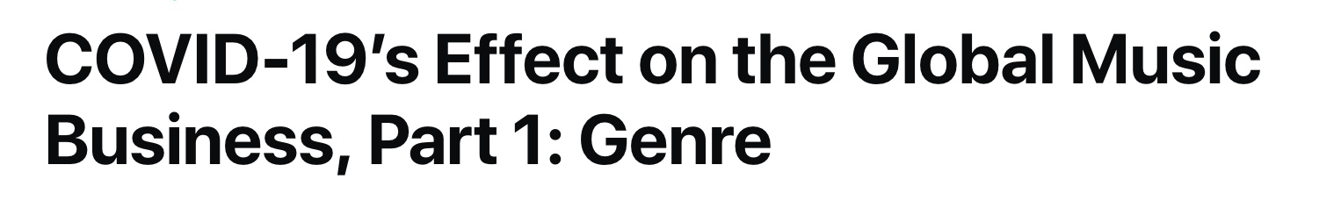
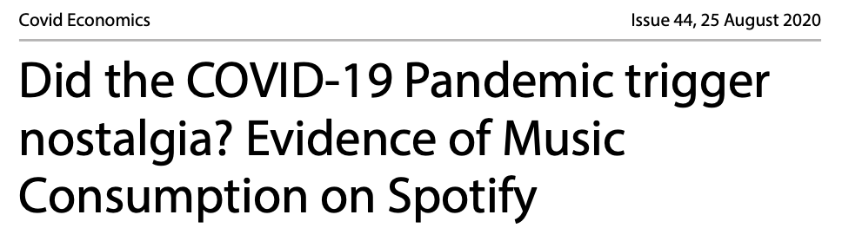
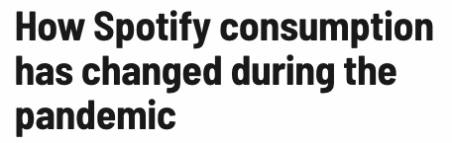
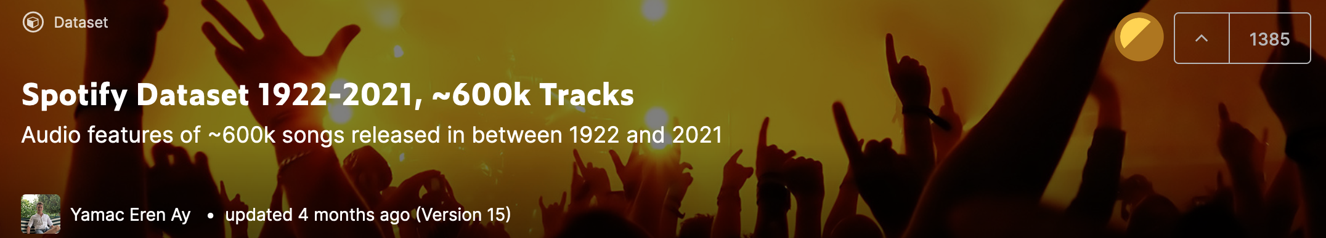
Motivation: Why did we choose this project?
Notes:
Talking Points:
Key Question
Our Alternate hypothesis and Null Hypothesis
Our Data Source (limited to US data). Why did we choose this data set?
Why did we choose this time frame?

Slide 3
Hypothesis: Music released in January 2020 through April 2021 was statistically different than music released in 2015-2019 according to *various metrics, likely a result of the COVID-19 pandemic.
Key Question: Comparing Spotify data from the past five years, what impact did COVID-19 on music streaming and music released?
Null Hypothesis:
Music released in January 2020 through April 2021 was not statistically different than music released in 2015-2019 according to *various metrics, likely a result of the COVID-19 pandemic.
Data Source: (Sample dataset of a 160,000 songs)
Spotify Dataset 1922-2021 (Audio features of ~600k songs released in between 1922 and 2021)
https://www.kaggle.com/yamaerenay/spotify-dataset-19212020-160k-tracks?select=data_by_genres_o.csv
*metrics will be defined in the following slides
Notes:
Talking Points:
Key Question
Our Alternate hypothesis and Null Hypothesis
Our Data Source (limited to US data). Why did we choose this data set?
Why did we choose this time frame?

Slide 4
Hypothesis: Music released in January 2020 through April 2021 was statistically different than music released in 2015-2019 according to various metrics, likely a result of the COVID-19 pandemic.
*All metrics except Tempo and Explicitness are scored in scale of 0 (low confidence) to 1 (high confidence)
Metrics
Danceability: How suitable a track is for dancing based on a combination of musical elements.
Speechiness: Speechiness detects the presence of spoken words in a track.
Acousticness: A confidence measure of whether the track is acoustic (i.e. the track was performed acoustically, without electronic instruments).
Energy: A perceptual measure of intensity and activity (Fast, loud, noisy).
Instrumentalness: A measure that predicts whether a track contains no vocals, not counting mouth sounds like "ooh" and "aah."
Liveness: Detects the presence of an audience in the recording.
Valence: The musical positiveness conveyed by a track.
Tempo: The overall estimated beats per minute (BPM).
Explicitness: Whether a song contains explicit content.
*All metrics except Tempo and Explicitness are measured on a scale of 0.0 to 1.0
Danceability | How suitable a track is for dancing based on a combination of musical elements.
Speechiness | Speechiness detects the presence of spoken words in a track.
Acousticness | A confidence measure of whether the track is acoustic (i.e. the track was performed acoustically, without electronic instruments).
Instrumentalness | A measure that predicts whether a track contains no vocals, not counting mouth sounds like "ooh" and "aah."
Energy | A perceptual measure of intensity and activity (Fast, loud, noisy).
Liveness | Detects the presence of an audience in the recording.
Valence | The musical positiveness conveyed by a track.
Tempo | The overall estimated beats per minute (BPM).
Explicitness | Whether or not the episode has explicit content (explicit=1; not-explicit=0).
Notes:
Talking Points:
Define each of the metrics
What were some common groupings? Why?

Slide 5


Metrics
Uptown Funk | Mark Ronson (ft. Bruno Mars)
Goodbye | Billie Eilish
Danceability | .856
Energy | .609
Speechiness | .082
Acousticness | .008
Instrumentalness | .001
Liveness | .034
Valence | .928
Danceability | .153
Energy | .138
Speechiness | .050
Acousticness | .837
Instrumentalness | .550
Liveness | .254
Valence | .050
Notes:
Talking Points:
Define each of the metrics
What were some common groupings? Why?

Slide 6
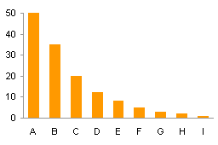
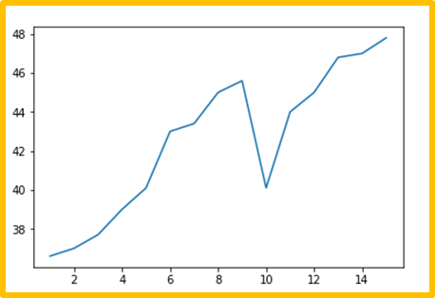
Key Questions
Did the various metrics of music change over the last 5 years?
Did the various metrics of music change during the COVID-19 Pandemic?
Did the metrics of tracks streamed change in the last 5 years?
Did the metrics of tracks streamed change during COVID-19?
Visualizations Used
Statistical Analysis
Bar Graph
Line Graph
Two-sample t-test
MANOVA
AOV
Notes:
Talking Points
Review top 3 questions:
Explain why we chose to see our data by year AND by quarter
What were our expectations?
What types of graphs did we use and why?

Slide 7
Music released in January 2020 through April 2021 was statistically different than music released in 2015-2019.
Summary: Our analysis supported our hypothesis.
Notes:
Talking Points:
Statement of findings (does our data prove or disprove our hypothesis)
Overview analysis
What statistical analysis model helped us the most?

Slide 8
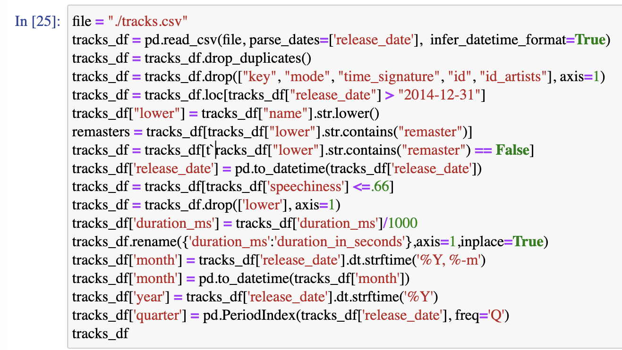
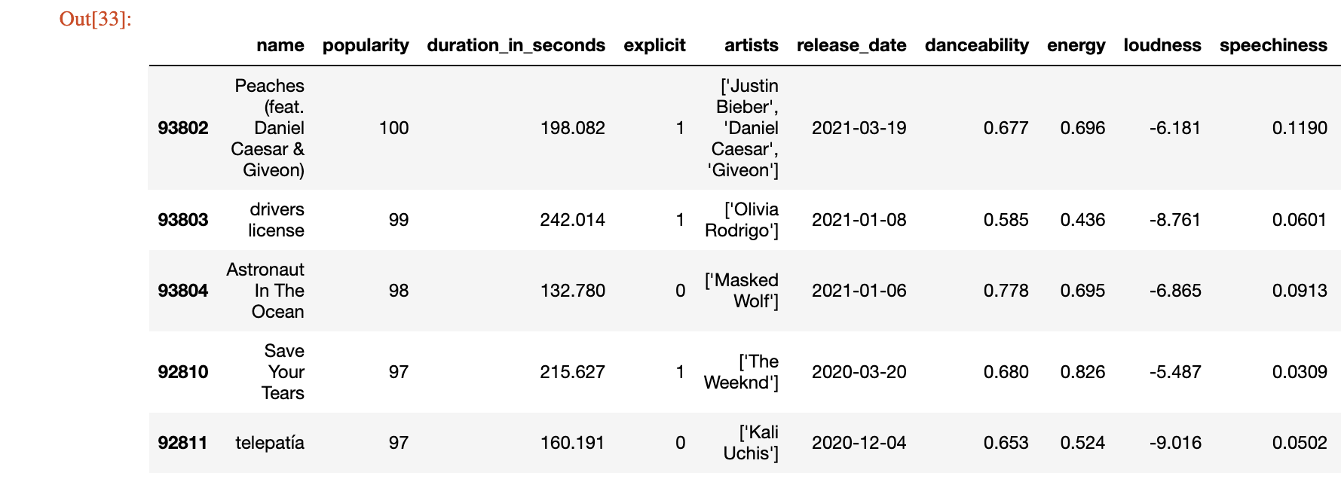
Prepping the Data
Raw Data: Random tracks released from 1922 to 2021 (> 600k tracks)
Narrowed Date Range: 2015-2021
Basic Clean-Up Dropped duplicate rows, removed all “Remastered” songs, converted tempo column to 0-1 scale
Determined 7 Metrics for Analysis Dropped extraneous metrics not useful to our analysis (ID, ID_Artist, key, mode, time_signature)
Dropped Spoken Word Tracks Dropped tracks with “speechiness” scores over 0.66, since tracks over 0.66 are not considered music.
Created variables for Month, Quarter, and Year, from release dates for analysis
*Spotify Data Clean-Up Jupyter Notebook found on the Spotify Project 1 GitHub link
Notes:
Talking Points
Why did we have to clean up the data? (What about the original file did we want to change?)
What were some hiccups during the clean up process? How did we overcome them?

Slide 9
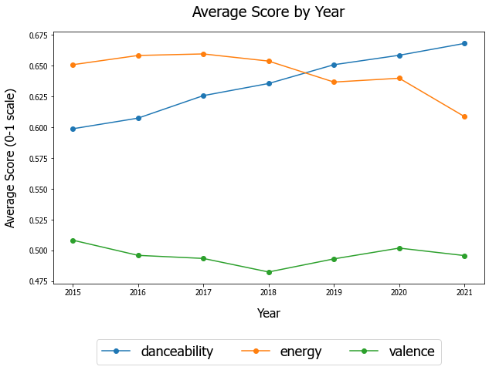
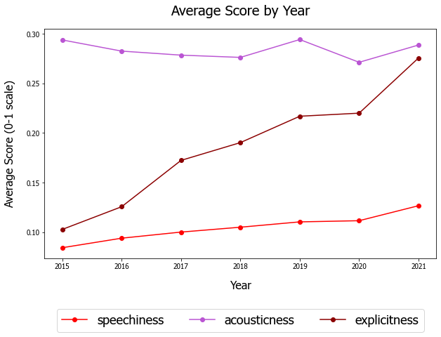
Question 1: Did the various metrics of music change over the last 5 years?
(By Year)
Notes:
Talking Points:
- Why grouping these metrics

Slide 10
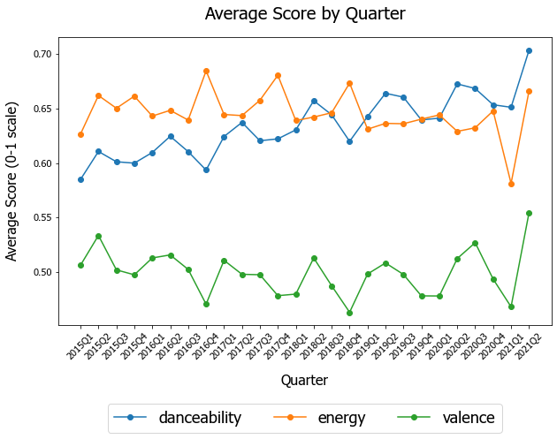
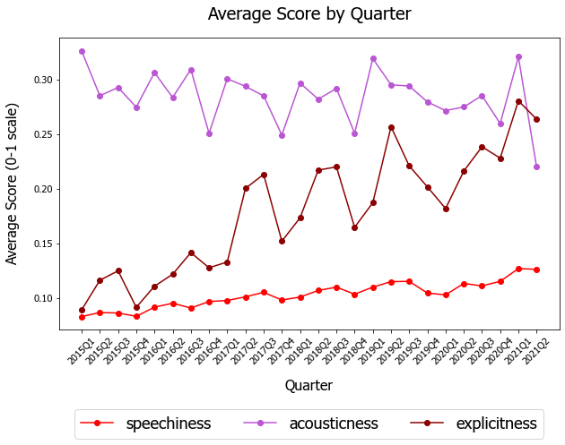
Question 1: Did the various metrics of music change over the last 5 years?
(By Quarter)
Notes:
Talking Points:
- Why grouping these metrics

Slide 11
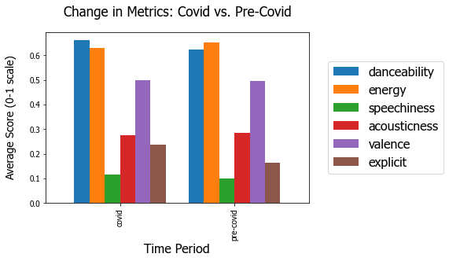
Question 2: How did the various metrics of music change during the COVID-19 Pandemic?
Pre-COVID-19 Dates:
January 1, 2015 – December 31, 2020
COVID-19 Dates:
January 1, 2020 –
April 30, 2021
Notes:
Talking Points:
- Why grouping these metrics

Slide 12
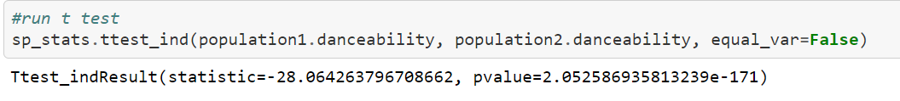
Statistical Analysis – t-test
Based on the previous chart, we identified danceability as a metric of interest.
Performed a two-sample t-test:
Hypothesis
Null Hypothesis – danceability scores of songs released did not increase by a statistically significant margin during the Covid time period as compared to the pre-Covid time period.
Alternative Hypothesis – danceability scores of songs released increased by a statistically significant margin during the Covid time period as compared to the pre-Covid time period.
P-value < .05, indicating we can reject the null hypothesis, and danceability is significantly different between the two time periods.

Slide 13
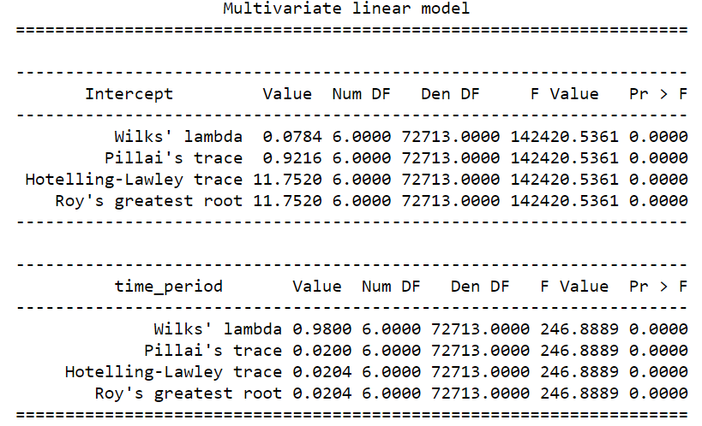
Statistical Analysis – MANOVA
Our t-test let us know that the danceability score was significant, but what about the others?
Performed a MANOVA to test if time period has a significant contribution to the dependent song score metrics.
Notes:
time_period does significantly contribute to the dependent music metrics for songs released as demonstrated by the p val < .05
however, the Wilks' lamda score (ranging 0-1) is very far from zero.
meaning, the time_period does significantly contribute to the metrics, but not overwhelmingly so (e.g. 1- wilks' lamba of .98 = .02 explained by time_period)

Slide 14
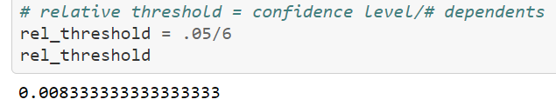
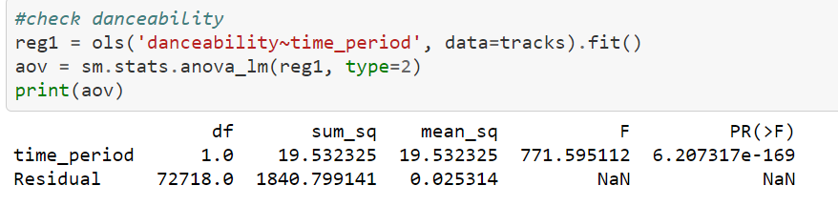
Statistical Analysis – AOV
One final check of our numbers to ensure there was not a type 1 error (can be present in MANOVA analysis)
Relative p-value threshold:
Findings
Time period contributed most to the difference in danceability
Time period contributed least to the difference in valence
All score metrics tested were below the relative p-value threshold
Performed an AOV on each score metric to ensure that time period contributed significantly to the observed difference in each metric
Notes:
time_period does significantly contribute to the dependent music metrics for songs released as demonstrated by the p val < .05
however, the Wilks' lamda score (ranging 0-1) is very far from zero.
meaning, the time_period does significantly contribute to the metrics, but not overwhelmingly so (e.g. 1- wilks' lamba of .98 = .02 explained by time_period)

Slide 15
Analysis:
Danceability and Energy metric scores most significantly changed
Danceability scores increased
Energy scores decreased
The change in scores could mean that songs released during Covid were more danceable, possibly to combat the mood of the pandemic.
What Stats tools did we use?
T-test, MANOVA, AOV
Why did we choose this graph type
Factors to consider
Normalization of dataset
Randomized sample (n for pre-covid is 3x larger than that of covid)
Other notes while graphing
Notes:
Chose line graphs because it was easy to see the change in the metrics over time
Chose the bar chart because it was helpful to see the side by side of metrics by time period
Factors to consider –
1. using annual averages may have smoothed out our data too much
2. the actual production of songs occurred prior to release date, so the change in score metrics doesn’t necessarily have to be covid related
3. wilks’ lambda from the manova states that while the time period contributes significantly, it doesn’t really explain that much

Slide 16
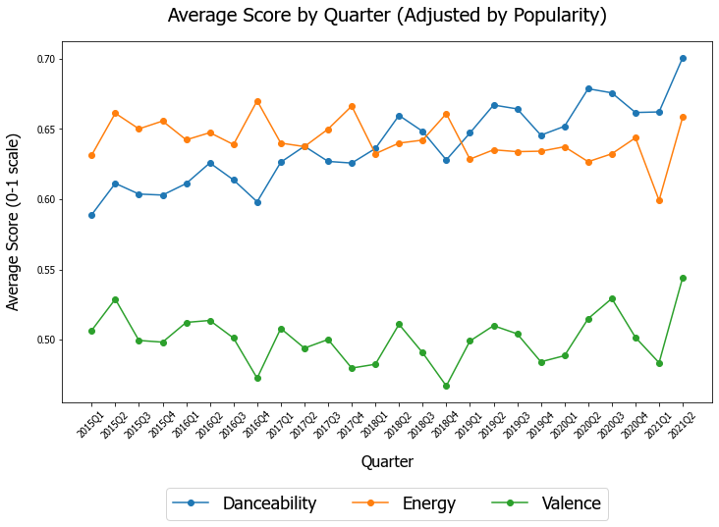
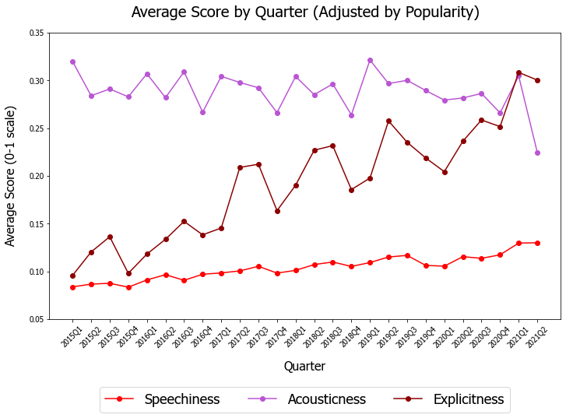
Question 3: Did the metrics of tracks streamed change in the last 5 years?*
*Streaming values derived from popularity value, using previously calculated power-law equation.

Slide 17
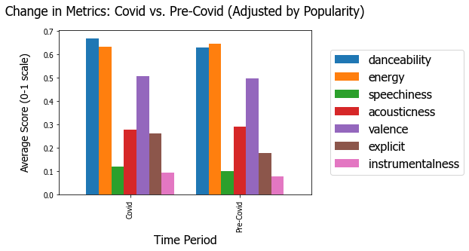
Question 4: Did the metrics of tracks streamed change during COVID-19?
Pre-COVID-19 Dates:
January 1, 2015 – December 31, 2020
COVID-19 Dates:
January 1, 2020 –
April 30, 2021
Notes:
Talking Points:
- Why grouping these metrics

Slide 18
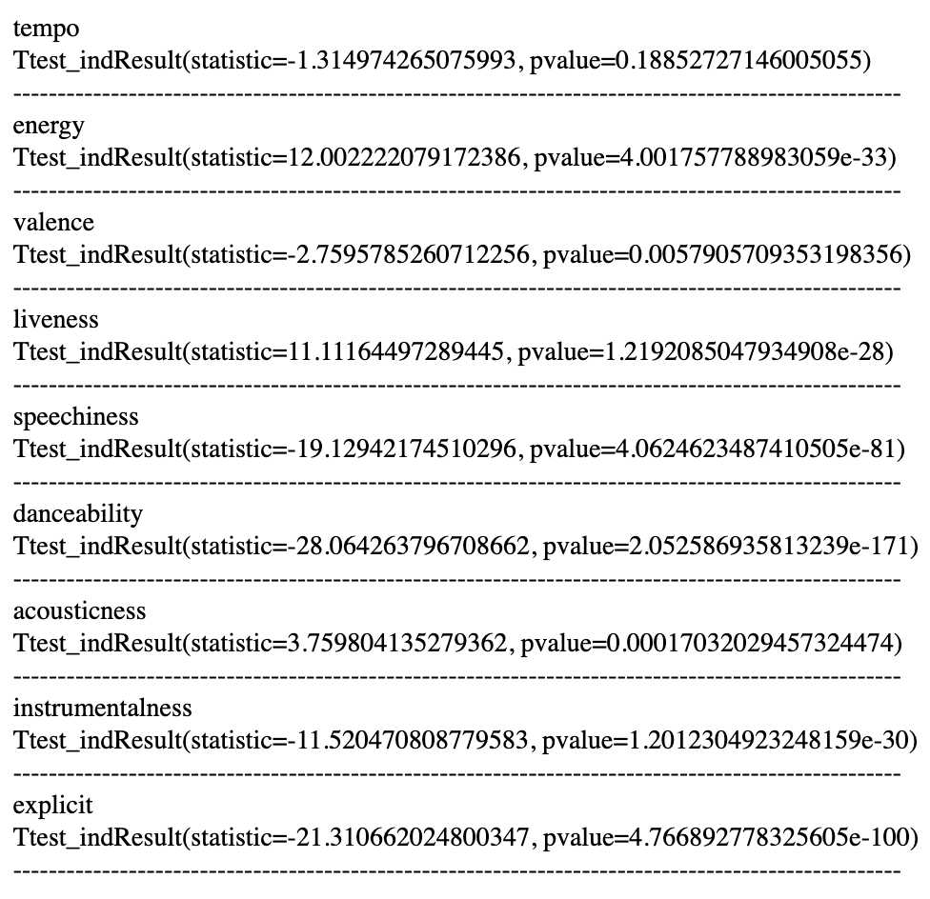
Statistical Analysis – T-Test
Performed a two-sample t-test for every metric. T-test showed a statistically significantly difference in means for all metrics, except for tempo.
Measure | P
Energy | .0001
Valence | .0001
Liveness | .0001
Speechiness | .0001
Danceability | .0001
Acousticness | .0001
Instrumentalness | .0001
Explicitness | .0001

Slide 19
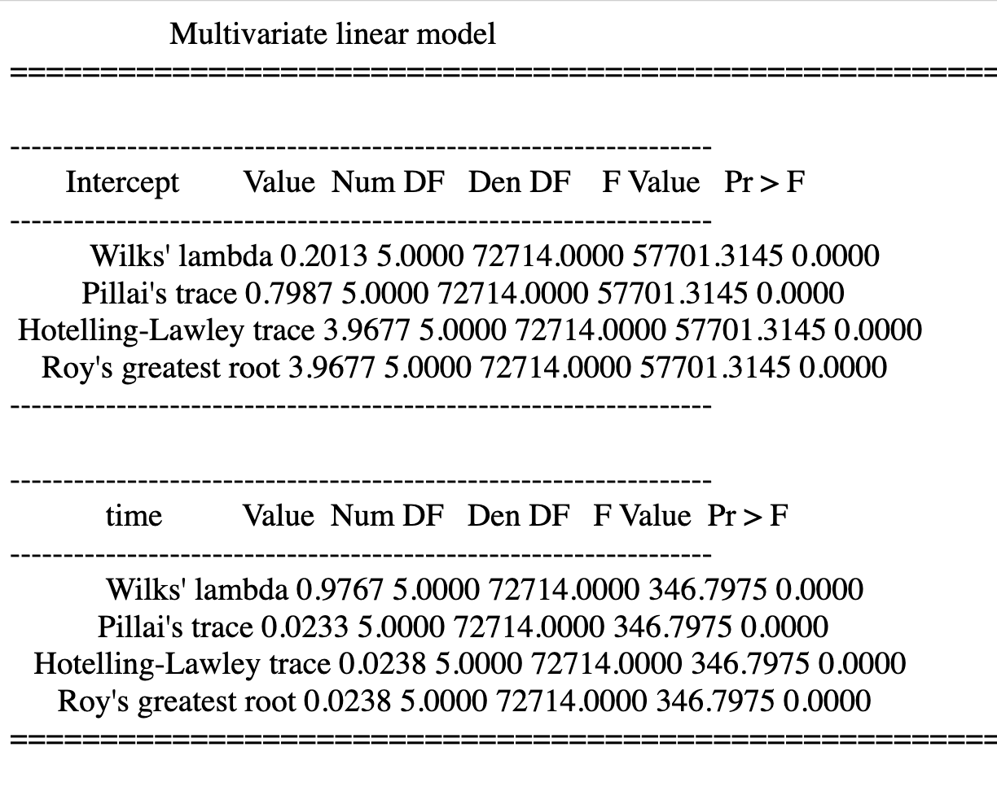
Statistical Analysis – MANOVA
Performed a MANOVA (Multivariate analysis of variance) to analyze the effect of time period on dependent song score metrics.
Wilks’ Lambda Value Although time period was statistically significant, it did not contribute much.
Notes:
time_period does significantly contribute to the dependent music metrics for songs released as demonstrated by the p val < .05
however, the Wilks' lamda score (ranging 0-1) is very far from zero.
meaning, the time_period does significantly contribute to the metrics, but not overwhelmingly so (e.g. 1- wilks' lamba of .98 = .02 explained by time_period)

Slide 20
Statistical Analysis – AOV
Metric | F | P
Energy | 138.41 | .001
Valence | 7.44 | .006
Liveness | 112.63 | .001
Speechiness | 396.91 | .001
Danceability | 771.60 | .001
Acousticness | 13.84 | .001
Instrumentalness | 150.10 | .001
Explicit | 516.88 | .001
Performed AOV One final check of our numbers to ensure there was not a type 1 error (can be present in MANOVA analysis)
Used previously calculated relative p-threshold (.0083)
Performed AOV Conducted AOV for each score metric to ensure that time period contributed significantly to the observed difference in each metric
Notes:
time_period does significantly contribute to the dependent music metrics for songs released as demonstrated by the p val < .05
however, the Wilks' lamda score (ranging 0-1) is very far from zero.
meaning, the time_period does significantly contribute to the metrics, but not overwhelmingly so (e.g. 1- wilks' lamba of .98 = .02 explained by time_period)
Used previously referenced relative p-value threshold

Slide 21
Analysis 3 & 4:
Danceability and Explicit metric scores changed most significantly
Both scores increased
The change in scores indicate that songs streamed during Covid were more danceable and explicit
What Stats tools did we use?
T-test, MANOVA, AOV
Why did we choose this graph type
Factors to consider
Normalization of dataset
Randomized sample (n for pre-covid is 3x larger than that of covid)
Notes:
Chose line graphs because it was easy to see the change in the metrics over time
Chose the bar chart because it was helpful to see the side by side of metrics by time period
Factors to consider –
1. using annual averages may have smoothed out our data too much
2. the actual production of songs occurred prior to release date, so the change in score metrics doesn’t necessarily have to be covid related
3. wilks’ lambda from the manova states that while the time period contributes significantly, it doesn’t really explain that much

Slide 22
Overall Findings
Utilizing our dataset, we found that…
…music released in January 2020 through April 2021 was statistically different than music released in 2015-2019, possibly a result of the COVID-19 pandemic.
Notes:
Other findings – verbally answer the questions during the talk
1. Yes and no. We expected that danceability and energy would have the same trend, but it did not. Didn't expect releases to increase during Covid due to all of the supply chain/quarantine disruption
2.

Slide 23
Factors to Keep in Mind
Limitation in sample size
No clear explanation of how data is collected and how metrics are scored
Lag time between the recording date and the released date
Music has been changing for the past 5 years --- how much of it was independently due to COVID?
Notes:
ratna

Slide 24
Additional Questions
Discuss any additional questions that came up, but which you didn't have time to answer: What would you research next, if you had two more weeks?
Change in music consumption (spotify subscription trends) during the pandemic
How did music trends change by genre?
Change in user demographics and differences in music that they listen to
How many new artists came in Spotify?
Change in existing artist popularity?
What are songs in playlists with COVID title?
Notes:
Seong-Min

Slide 25
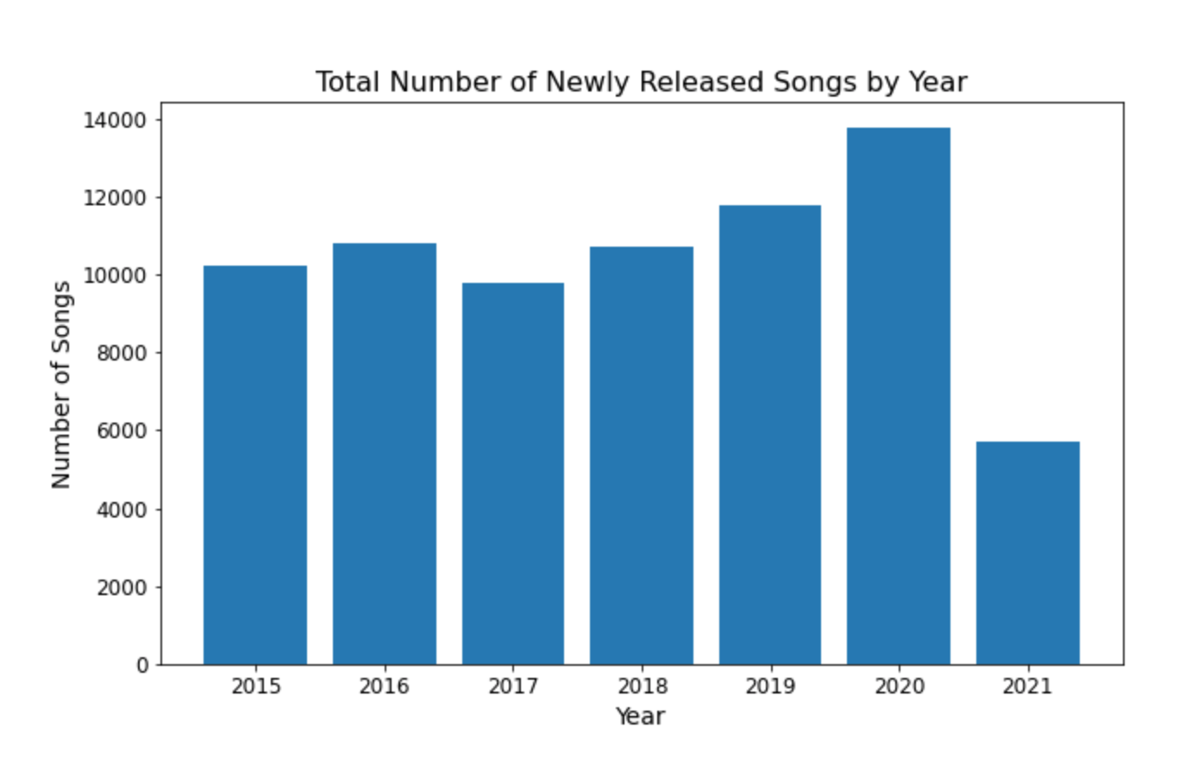
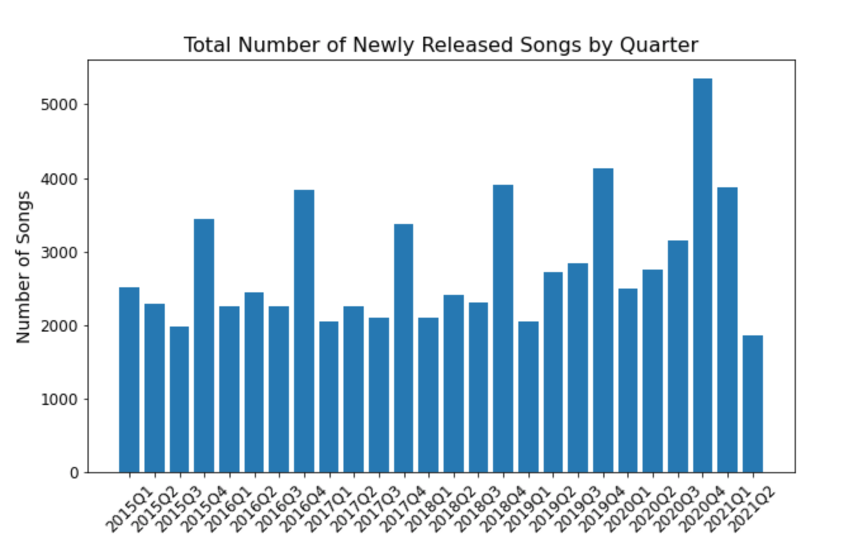
Question 1: Did the volume of music released increase or decrease during the COVID-19 Pandemic?

Slide 26
Analysis 1: (Answer)
What do these graphs show?
What does this mean?
Why did we choose this graph type
Factors to consider
Other notes while graphing
Statement (does this evidence support or deny our Hypothesis?)

